Slide 1


Data Analytics Project

Slide 2


Today's agenda:
Project recap
Problem
The Analytics team
Process
Insights
Summary

Slide 3

In the IT industry, "Social Buzz" is a unicorn that is growing quickly and has to swiftly adapt to its worldwide reach.
During a three-month POC, Accenture has begun working on the following projects:
An analysis of Social Buzz's big data usage.
A successful initial public offering (IPO) strategy.
A review to ascertain Social Buzz's top 5 content categories.
Project Recap
Notes:
Let me begin by summarizing the purpose of this relationship. Accenture and Social Buzz have started a three-month trial program where we will concentrate on three key activities that are in line with some of the most pressing issues you are now dealing with. In recent years, Social Buzz has grown to an enormous extent, earning recognition as a unicorn firm on a worldwide basis. We are available to assist you in controlling this scale and to point you in the proper path. Initially, we will conduct an audit of your big data business and exchange industry knowledge and best practices. Furthermore, our staff has extensive experience and understanding in successfully executing initial public offerings (IPOs), which we will be leading you through. subsequently, we have examined your data to obtain information about the five most popular content categories that you have.

Slide 4

→Social Buzz has more than 500 million monthly active users throughout the previous five years.
→ Over 100,000 items of content are produced everyday.
Annually, Social Buzz processes an immense volume of data amounting to 36,500,000 units.
→ The top 5 categories with the highest aggregate popularity are highlighted in an examination of their content categories.
Problem
Notes:
1. Over the previous five years, Social Buzz has consistently maintained a user base of over 500 million monthly active users, highlighting its noteworthy presence in the digital environment. 2. The platform produces an incredible amount of material every day—over 100,000 items—which reflects the high degree of community activity and user involvement. 3. Social Buzz handles 36,500,000 units of data annually, demonstrating the platform's strong infrastructure and ability to efficiently handle large-scale data operations. 4. Looking at Social Buzz's content categories, the top 5 most popular overall provide important information about user preferences and trends that influence platform engagement.

Slide 5




ANDREW FLEMING
Chief Technology Architect
The Analytics team
MARCUS ROMPTON
Senior Principal
DEVENDER BANOTH
Data Analyst
Notes:
Accenture has a sizable data analytics unit, but we only had three individuals working on this project at a time.
Chief technology architect Andrew Flaming: who worked on digital transformation projects with more than fifty customers and advised some of the world's largest corporations! about their approach to big data. Andrew oversees making sure we provide excellent data insights and a sound data strategy.
Marcus's area of specialty is his understanding of corporate statistics, especially that of the media and entertainment sectors. Managing and supervising the analysis's findings that we offer will be his primary responsibility.
Data analyst Devender Banoth is an expert in analyzing data on the fly and converting project specifications into useful insights. He makes a substantial contribution to well-informed decision-making and the success of projects.

Slide 6
Process
1
Data understanding
2
Data Cleaning
3
Data Modelling
4
Data Analysis
5
Insights
Notes:
- Data Understanding: Since a solid understanding of Social Buzz's data model and domain is essential to the project's success, we started there. - Data Extraction: After the first comprehension stage, we designed an optimal dataset customized to tackle the noted difficulties and effectively retrieved important data from relevant sources. - Data Processing and Modeling: After we acquired raw data, we turned our attention to methodically processing and modeling it to create a polished dataset ready to produce insights and analytics that could be put to use. - Analytical Insights: Making use of our analytical skills, we examined the dataset to extract insightful information that was subsequently turned into visuals that clearly communicated the main conclusions. - Business Impact: By using these insights as a guide, we helped decision-makers make well-informed choices and offered tactical advice to advance Social Buzz..

Slide 7

Insights
Unique Categories
16
Highest scored category (Animal)
74K
May has the highest volume of posts.
Notes:
1. Within the dataset, a total of 16 unique categories have been identified, showcasing the diverse range of content present on the platform.
2. Among these categories, "Animal" emerges as the highest scored category, boasting an impressive count of 74,965 posts, indicating its popularity and relevance among users.
3. Analysis reveals that the month of May records the highest volume of posts compared to other months, underscoring a peak in user activity during this period.

Slide 8
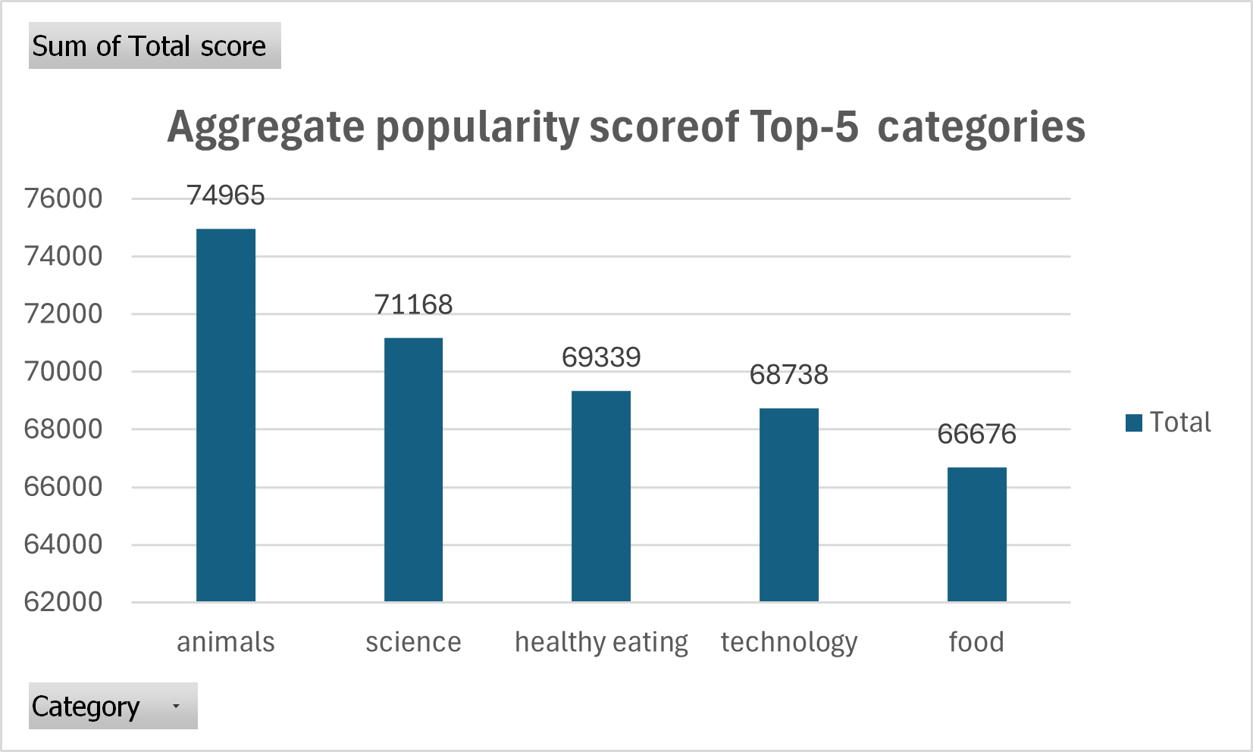

Slide 9
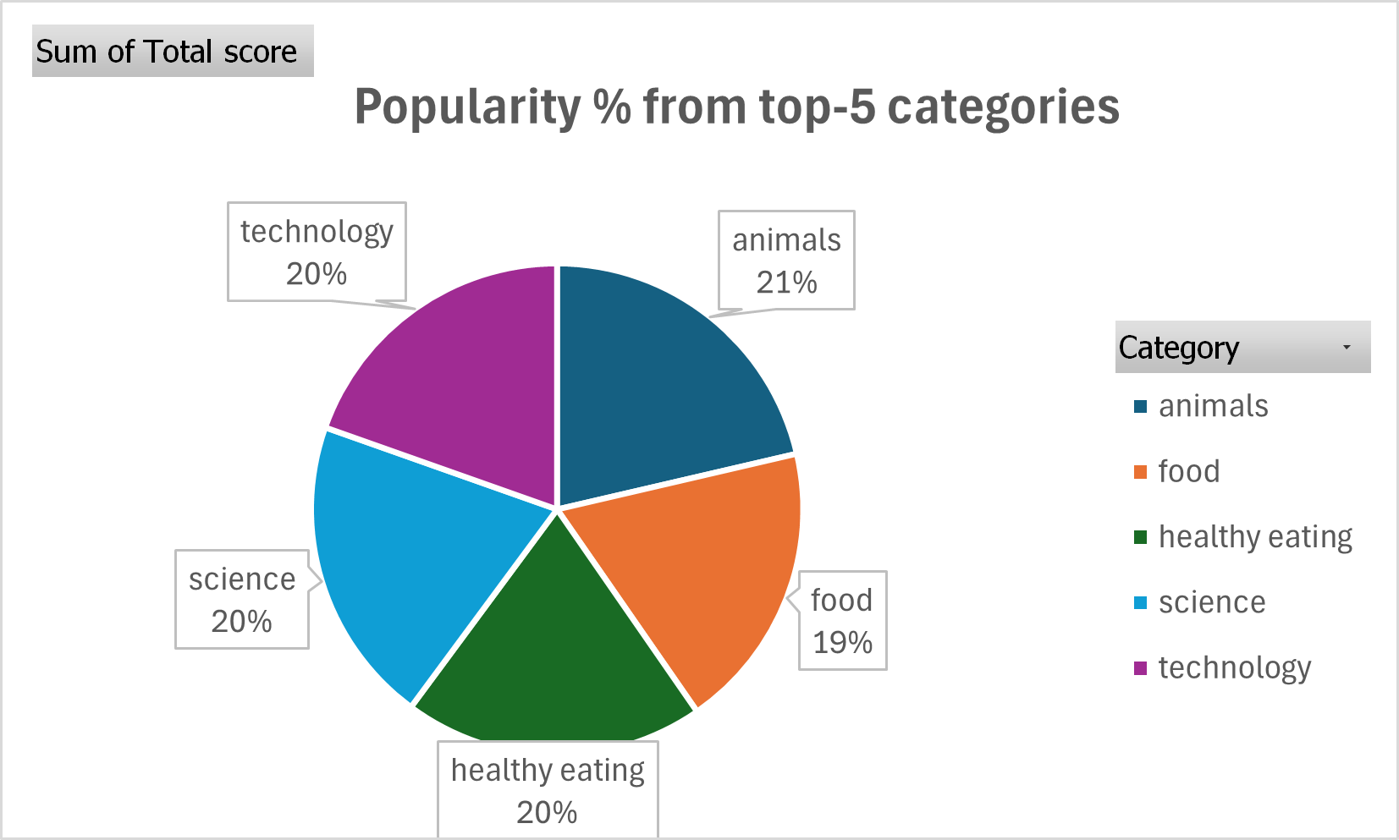
Notes:
According to analysis, Animals has the greatest engagement rate (21%), out of all the top content categories, suggesting that consumers are highly interested in it. Science, Technology, and Healthy Eating come a close second and third, respectively, with noteworthy involvement rates of 20%. Food also attracts a lot of attention, with a commendable 19% engagement rate. These percentages highlight the wide range of interests held by the user community, with factual material, health-related subjects, and technology innovations receiving particular attention. By using this data, strategies for partnerships and customized content production may be developed in order to take advantage of user preferences and promote long-term engagement and platform growth.

Slide 10

Analysis:
→The most popular content categories are "Animals" and "Science," suggesting a desire for factual and real-world information.
→Recommendation: To keep users interested, concentrate on producing more material in these areas.
Insight:
→"Healthy Eating" is one of the top 5 categories, suggesting that users have similar interests.
→Prospect: Suggested using this information to work with companies that promote healthy eating and develop marketing aimed at increasing user involvement.
Next steps:
→High ranking technological content indicates users' interest in technological progress.
→Suggestion: Encourages cooperation with top digital firms to boost platform expansion and user engagement.
Summary
Notes:
The data reveals that "Animals" and "Science" emerge as two of the most popular content categories, indicating a preference for real-life and factual content among users. Therefore, I recommend focusing on creating more content related to these categories to maintain user engagement and satisfaction.
In addition, "Food" shows up as a recurring theme in the top 5 categories, with "Healthy Eating" taking the top spot. This realization offers a chance to focus on the audience interested in adopting healthy eating practices. Working together to develop campaigns with companies that promote healthy eating might greatly increase user engagement and promote brand alliances.
It is clear from the popularity of technical content that people value your technological content. Partnering with top digital firms might increase user engagement even further and broaden your audience. As such, I advise looking into joint ventures with well-known digital companies to take use of their knowledge and assets, which will eventually boost platform expansion and user engagement.

Slide 11
Thank you!
ANY QUESTIONS?

